Slide 1
Open Your Services to the Public!
Notes:
8min Motivation
Mesh-Up-Fähigkeiten für die eigene Plattform anbieten
Nutzer motivieren angebotene Services über das Web hinaus zu nutzen
Kreativität der Nutzer ausnutzen (Web 2.0 Gedanke)
Ihnen die Möglichkeiten geben großartiges mit deinen Services zu verwirklichen
Zum Nachdenken über eigene Services anregen
12min: InstantSVC Features, Überblick
Natürlich dürfen diese zusätzlichen Schnittstellen keinen Mehraufwand bedeuten
Wenn man das Anbieten von Web Services in der Architektur berücksichtigt führt das oft zu klarerem Design (stärkere Schichtung)
Kann auch für AJAX genutzt werden, als Basis für Web 2.0 Oberflächen ;)
werkzeuggestützte Entwicklung notwendig für effiziente Softwareentwicklung
Konfiguration statt Programmierung
10min: Vorstellung der Tools und Gimmicks, Call-Graphen als Eye-Catcher
15min: Einfaches Beispiel: Der Web Service für deinen Anrufbeantworter, Fernabfrage

Slide 2
About the Project
Base project developed by 6 HPI students since october 2005
G. Gabrysiak, Ch. Hartmann, M. Perscheid, M. Sprengel
Today here: Stefan Marr and Falko Menge
Project presented at the FrOSCon 2006
Open steps: contribute base to eZ Components
Additional work
Access Control in Service Oriented Architectures
Implementation of Task-Role Base Access Control based on ServiceMix/Java and InstantSVC
Notes:
Think this slide goes here to show our experiences and qualifications on this topic
Anything to say about your work for TUK?

Slide 3
Agenda
Motivation
Short Introduction to InstantSVC
Architecture, Features
Tools
Live Demo: Adding a Web Service
Notes:
Service Orientation is one of the main issues software vendors and academias are currently working on. Unfortunately small software vendors and small to mid sized companies seams not to spend much effort in this area. Therefore, here are some motivations given to add services to existing software solutions and provide a standard-based and open infrastructure of web services.

Slide 4
Quick Survey
Who of you is developing web applications?
Who uses PHP?
What kind of applications?
Content Management
eCommerce
Collaboration Tools
“Enterprise Applications”
Other?
Notes:
After the quick survey:
Now lets think of your apps in parts of functionality.
These parts can be called services.
Now we speak not only about services for people, but also about services for other applications.
→ Next slide, samples of possible services referring to survey results

Slide 5
Services?
Blog with Web 2.0 stuff
Feeds, Publishing API, User Contribution, Single-Sign On,…
Shops
Catalog of Goods, Buying API, Availability Checks
Intention: Close the Media Gap
Enterprise Applications
Finance, Warehouse Management, Human Resources,…
Services provided by specialists
Used to build applications upon
Notes:
The term service refers not only to offers of computing based solutions. It includes all real world services you could think of. Hear cutting, craftsmen work, delivery of goods or manufacturing a car at customer's option.
Now, have a look at Web Services. They are the technical basement to offer those services to the world and provide a standardized way to allow customers to integrate the offered real world services into their business and make use of them.
You have heard of the fridge ordering coke or convenience foods on own behalf. If the thermometer is showing constantly to high temperatures it could send a repair order to a craftsman, too. That is possible, because you are providing a Web Service offering an interface which can be used to automate this order processing.
Sounds to spacy? Ok, let’s stick to more convincing examples.
Blogs are everywhere. What web services do they offer or use? You did like to stay in-touch with your friends or colleagues, just subscribe to their feeds with your favored feed reader. Most blogs offer interfaces to publish content with word-processing tools. User comments are posted via AJAX using a REST web service, too. Combined with a nice Single-Sign On solution, blogs can ask another web service, whether you are allowed to post your comments, without forcing you to enter your password at each blog again and again.
There may be no need to automate things beside the login, but if you’re looking at a simple web shop, you could start to compare prices and offers or let your fridge do so automatically. Just provide access to the catalog of your goods in a structured way and expose an interface to send you orders. After your shop system has done availability and validity checks it could forward this order to your shipping partner.
Eventually, enterprise applications will offer there services as web services to be integrated into a steady changing IT infrastructure to keep pace with changing business requirements. Furthermore, they will consume external services to reduce costs. Services from companies like yours; specialists in their field.

Slide 6
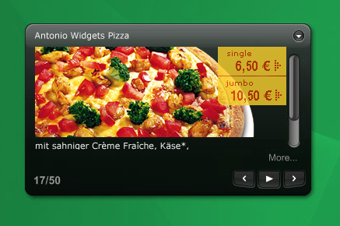
Services: For Whom?
Enterprise People
Innovators
Portals and Mesh-Ups
Personalization
Single-Point-Of-Access
Tools for there employees
Composite Applications
Workflows for their customers
Quick and cheap, but with convincing quality
It is cool
Everybody wanne have it
Is it Flickr, del.icio.us, Digg, Google Maps, Ebay?
Likely, it’s not!
You did not imagine what's possible with your services
They do!
Notes:
Who did like to build Apps based on your services?
You don’t imagine, but you’ll make them pay for your services, so you’ll earn money and get something to eat.
You’re not convinced and ask for whom you should provide your services as web services?
There will be two major stereotypes of possible users. Enterprise People and so called Innovators, may be even Inventors.
Enterprise People
As already outlined, enterprises will offer and consume services. With the internet and cheap communications and logistics we got globalization. Today, almost everybody can buy and sell goods or services allover the world. Thus, enterprise will choose the provider of goods and services by criteria like price and quality, not any longer predominantly by neighborhood.
And they do this using web services, because they need to reduce their personal costs and automate things where possible.
Large companies and software vendors like SAP encourage there employees to use Portals and Mesh-Ups to increase their productivity. This is because here the knowledge workers get a personalized workbench, as a Single-Point-Of-Access to their daily work. These portals are so called composite applications. Using web services to provide the functionality the user needs. Here they can change and enhance workflows and tools without the need of change the stable and reliable enterprise software it is build upon. This reduces costs and can reduce the time-to-benefit.
Here the idea is to build small parts of functionality inside of portals or rich client applications with out touching the enterprise infrastructure itself. The small parts can use what ever web service they need to offer the needed functionality as higher level service to the user.
Innovators
But what did Innovators do? Don’t know exactly.
They do the cool stuff. Something everybody would like to have.
May be your thinking in terms of Google, Google Earth, Flickr, Ebay or iPhone.
Ok, it has not to be new, but convincing. Probably they will do something you could not even think off, or they do it a way you never have had in mind. But the good news is. They need you. Your services. No iPhone without AT&T, no Flickr without its users. No shop without its customers.
Open your services to the public!
May be you still can’t imagine who is willing to pay you for your services, ordering it using web services.
But yesterday we ordered our pizza via phone or may be at an internet page. Tomorrow, at lunch time, my “Vista Side-Bar” is offering Pizza, Frosta-Food and this nice Chicken Special from the Indian around the corner. I can choose what ever I like and it’s delivered within hopefully 30 minutes.
The day after, it’s offering other dishes automatically, may be using Google and Google Map to estimate whether they could deliver in time. Even if you don’t know how it could be used, if there is anything that could be used, provide it as web services, your creative customers will be grateful.

Slide 7
Wish List of a Service Developer
Easily enhance existing applications
Low-Cost/Effort: because benefit might not be instantly visible
Support for latest technologies and all possible flavors
SOAP and REST as non-exclusive options
Security
Well, try it without guy ;)
Nice and nifty tools
They have to be sexy, and easy to use

Slide 8
What does PHP provide?
SOAP
The very basics, Client and Server
No tools, no PHP2WSDL generation
REST
Well, PHP is REST at its heart
But people don’t know it, so they need tools
No Security
Access Control is an application issue

Slide 9
InstantSVC: Basic Features
PHP is an dynamic language
Extended Reflection API with information about types
Annotations for PHP
Service description for service consumers
WSDL Generator conforming to WS-I Basic Profile
Services as add-on to existing applications
Document/Literal adapter generator
Security
Implementation of WS-Security and Username Token Profile

Slide 10
InstantSVC: Convenience Features
For SOAP Services
Handler chain mechanism for SOAP processing
For REST Services
Custom mapping of functionality to REST resources
Custom serialization handling
Administration tool for convenient creation und management of SOAP and REST services

Slide 11
Administration Front-End
Administration front-end
Automated creation of web services from existing applications
Annotations identify classes to be used
Administration via web browser
Classes and methods selected by user
Generates SOAP and REST server scripts
Generates WSDL file and adapter classes
SOAP server with WS-Security

Slide 12
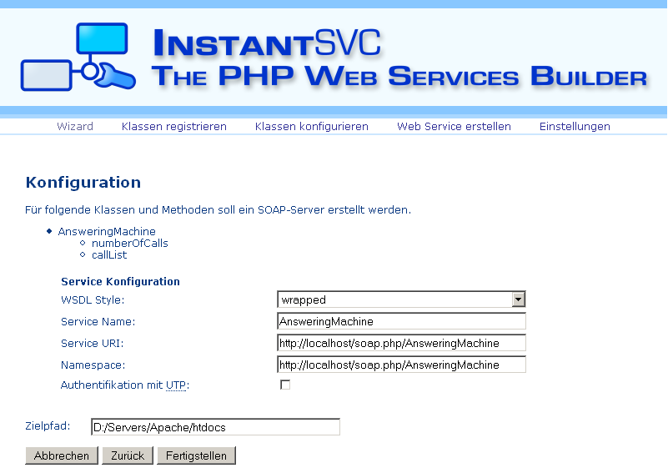
Administration Front-End

Slide 13
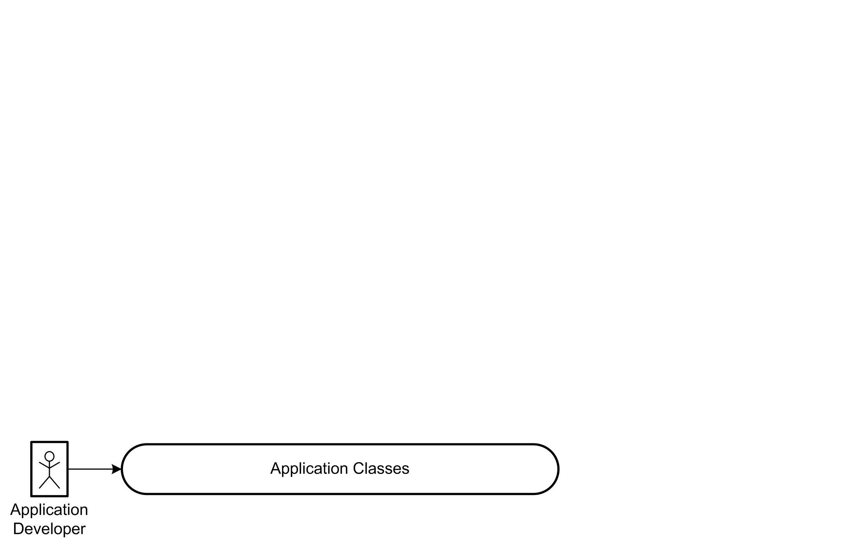
Interaction Overview

Slide 14
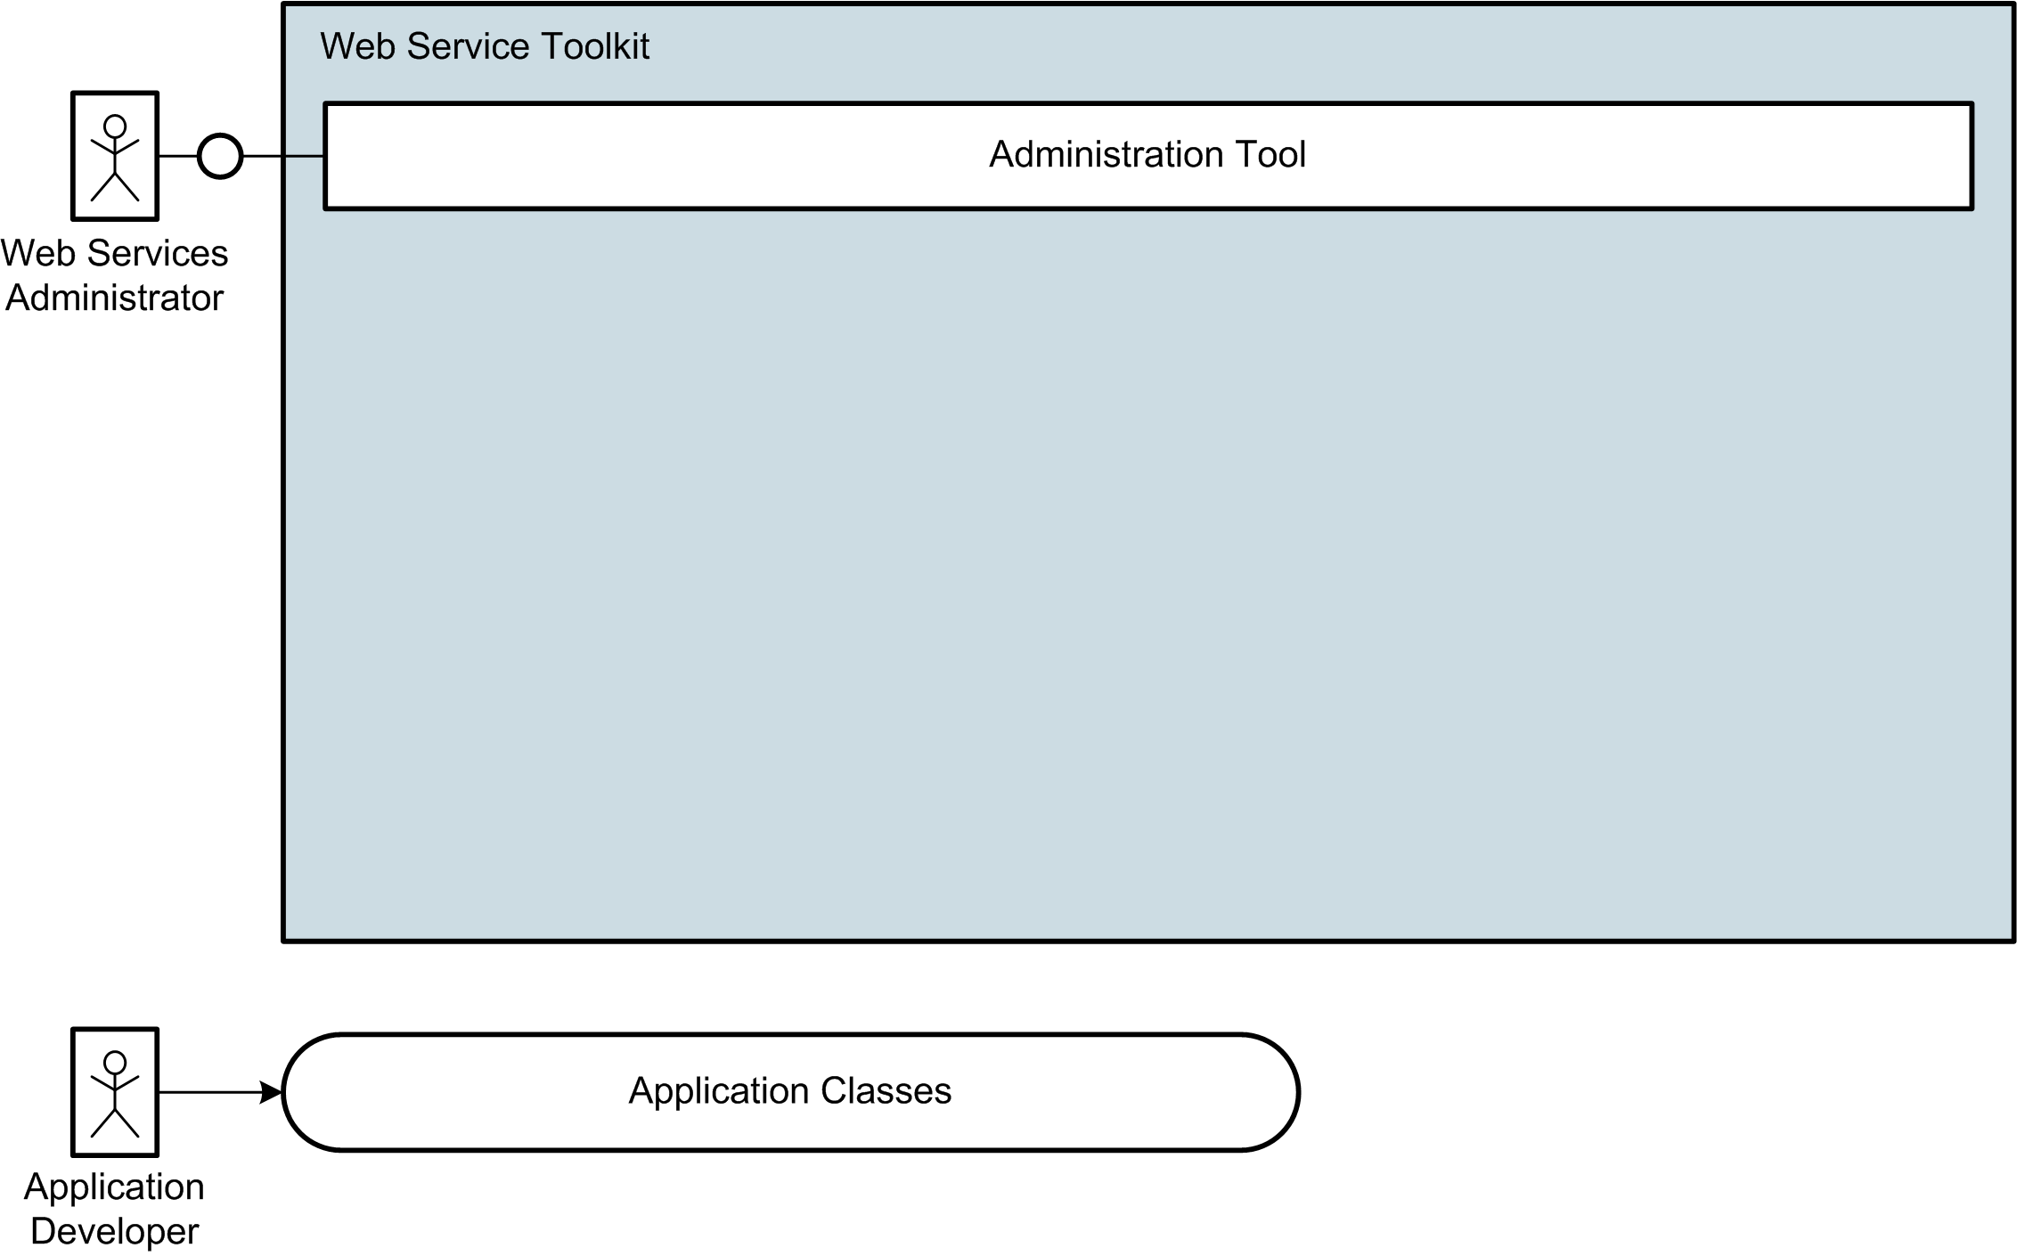
Interaction Overview

Slide 15
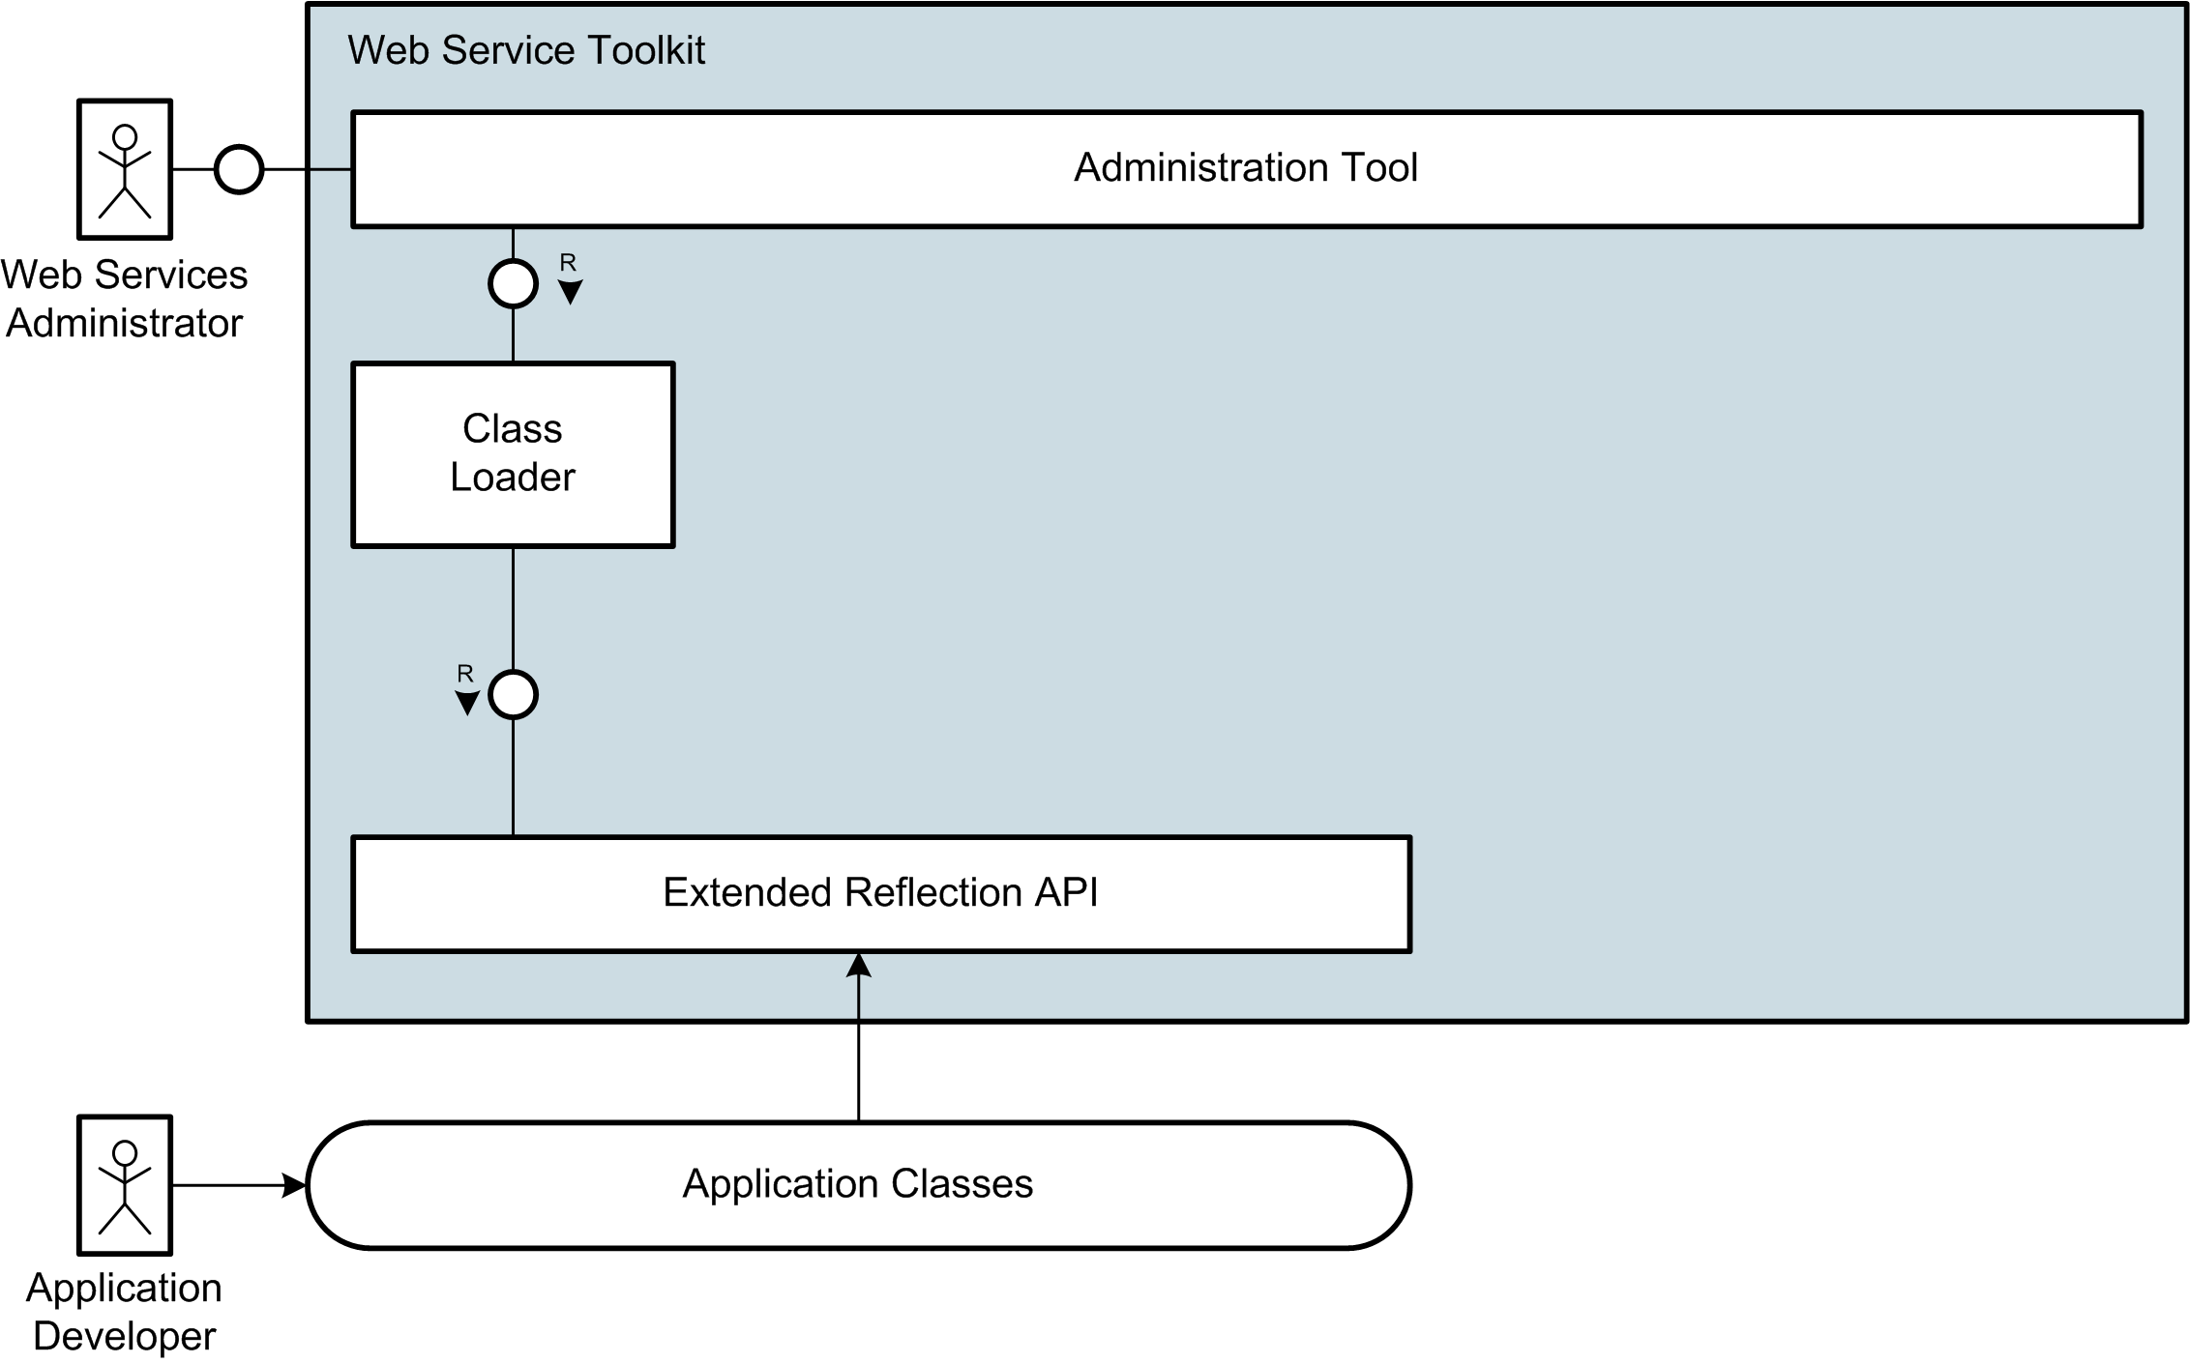
Interaction Overview

Slide 16
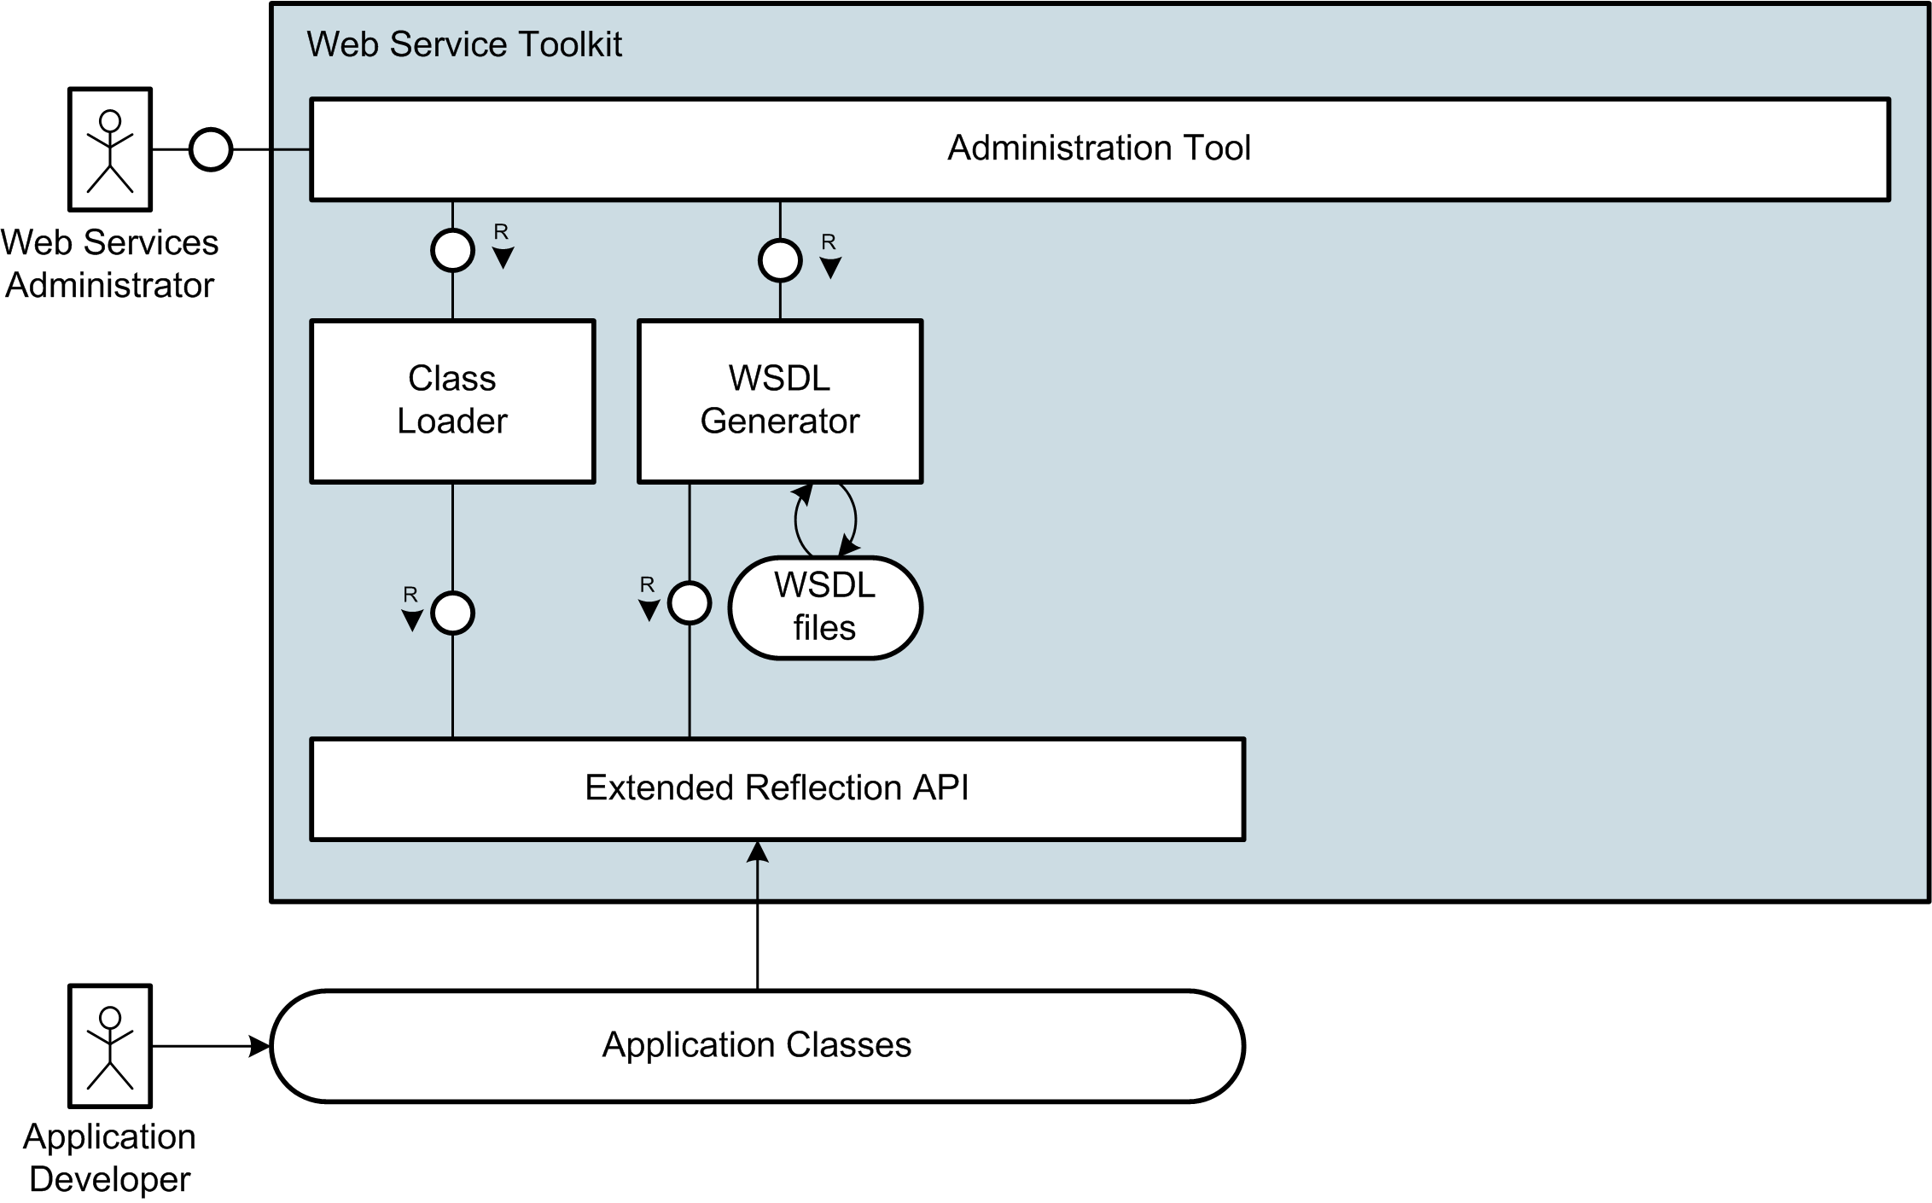
Interaction Overview

Slide 17
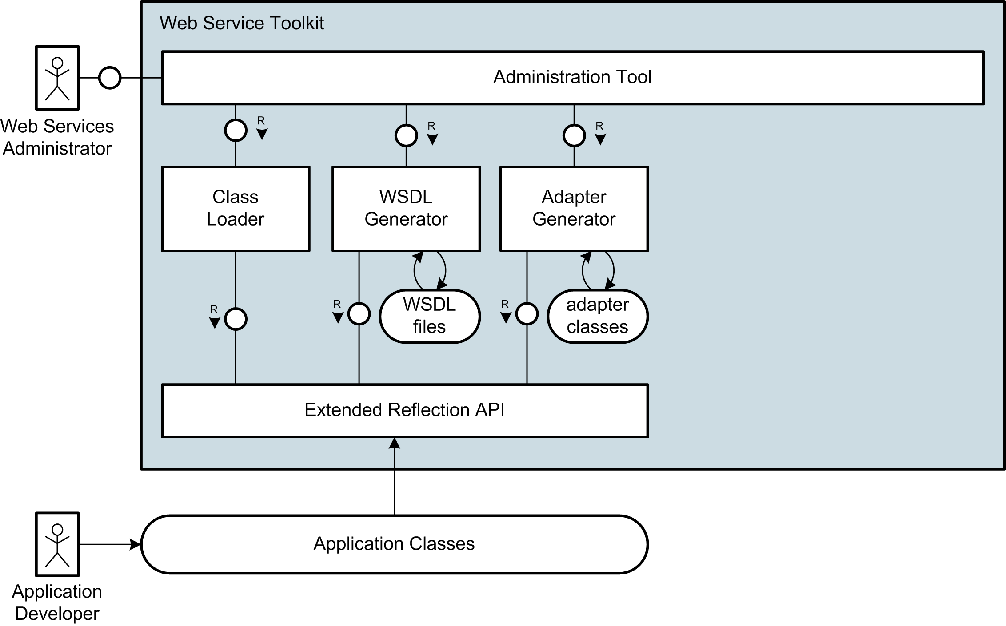
Interaction Overview

Slide 18
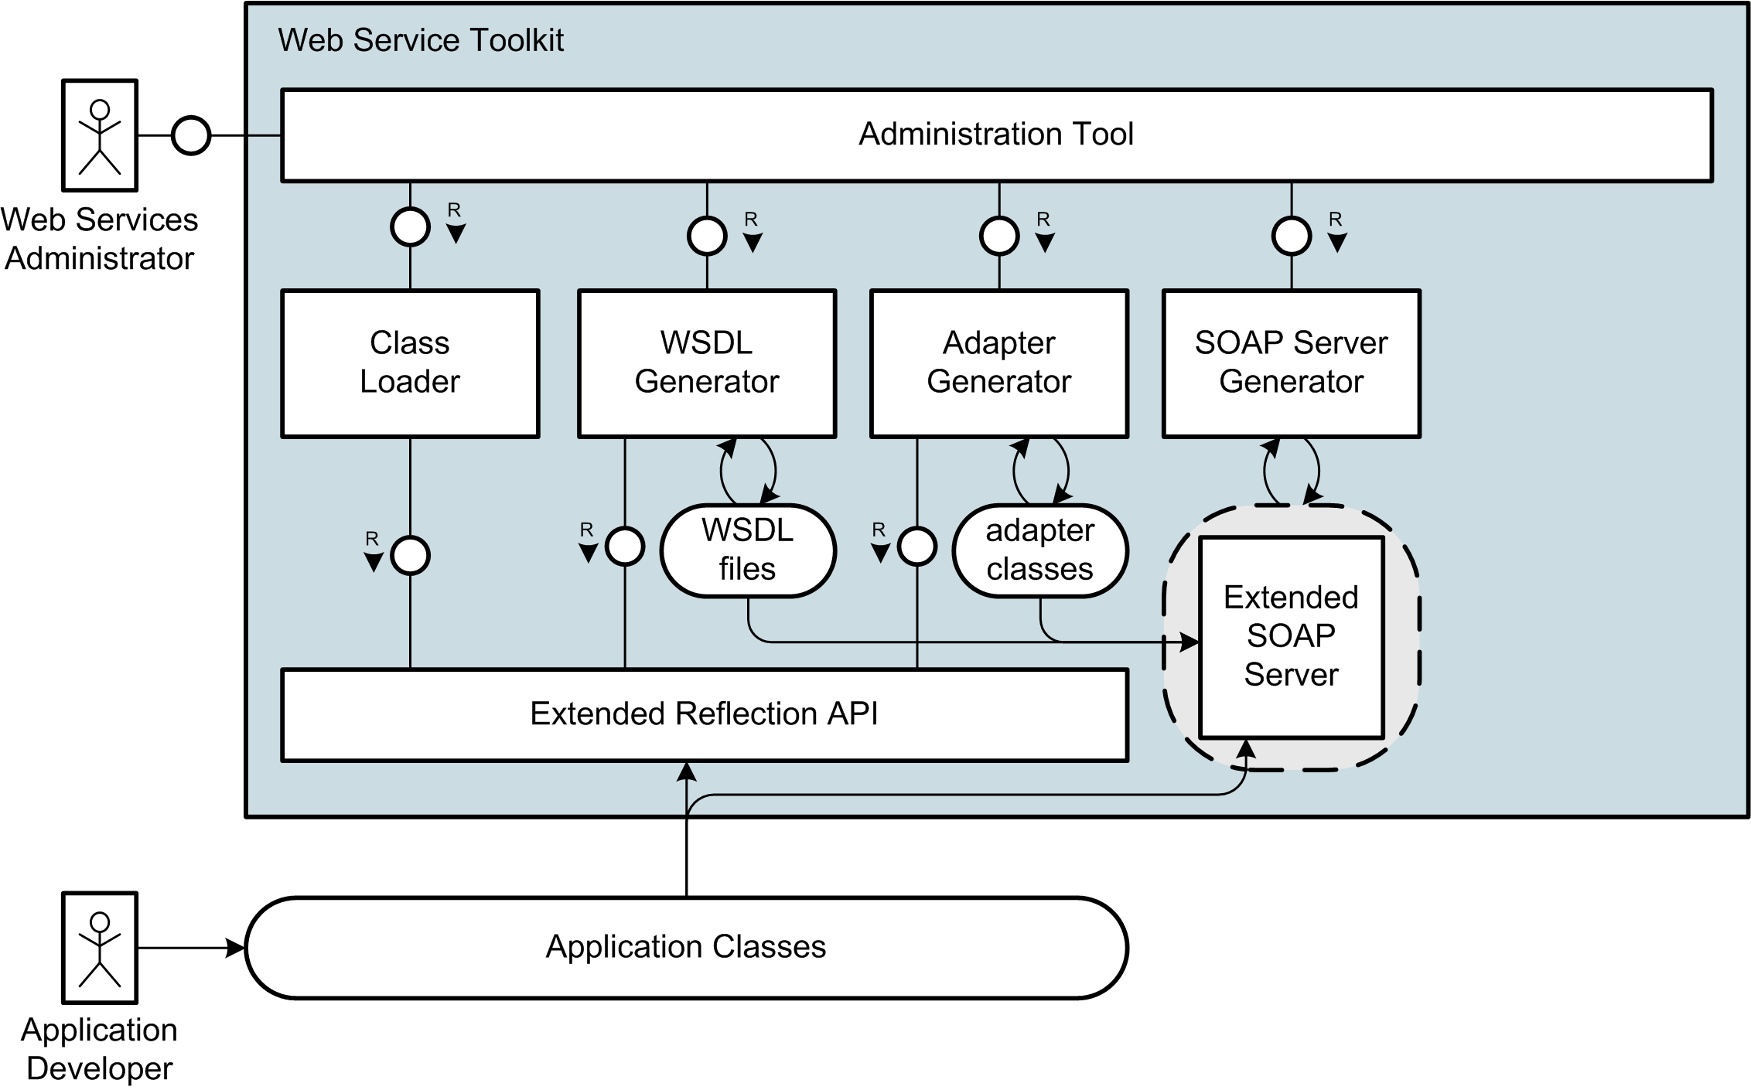
Interaction Overview

Slide 19
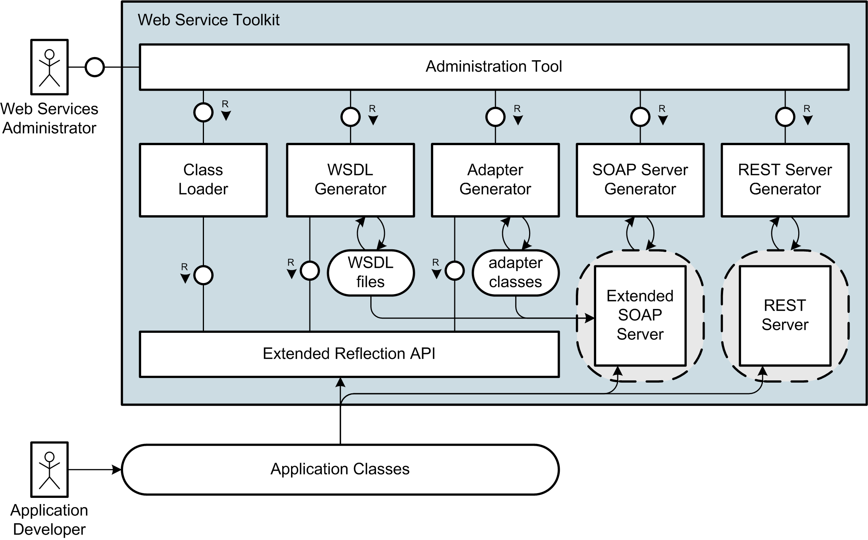
Interaction Overview

Slide 20
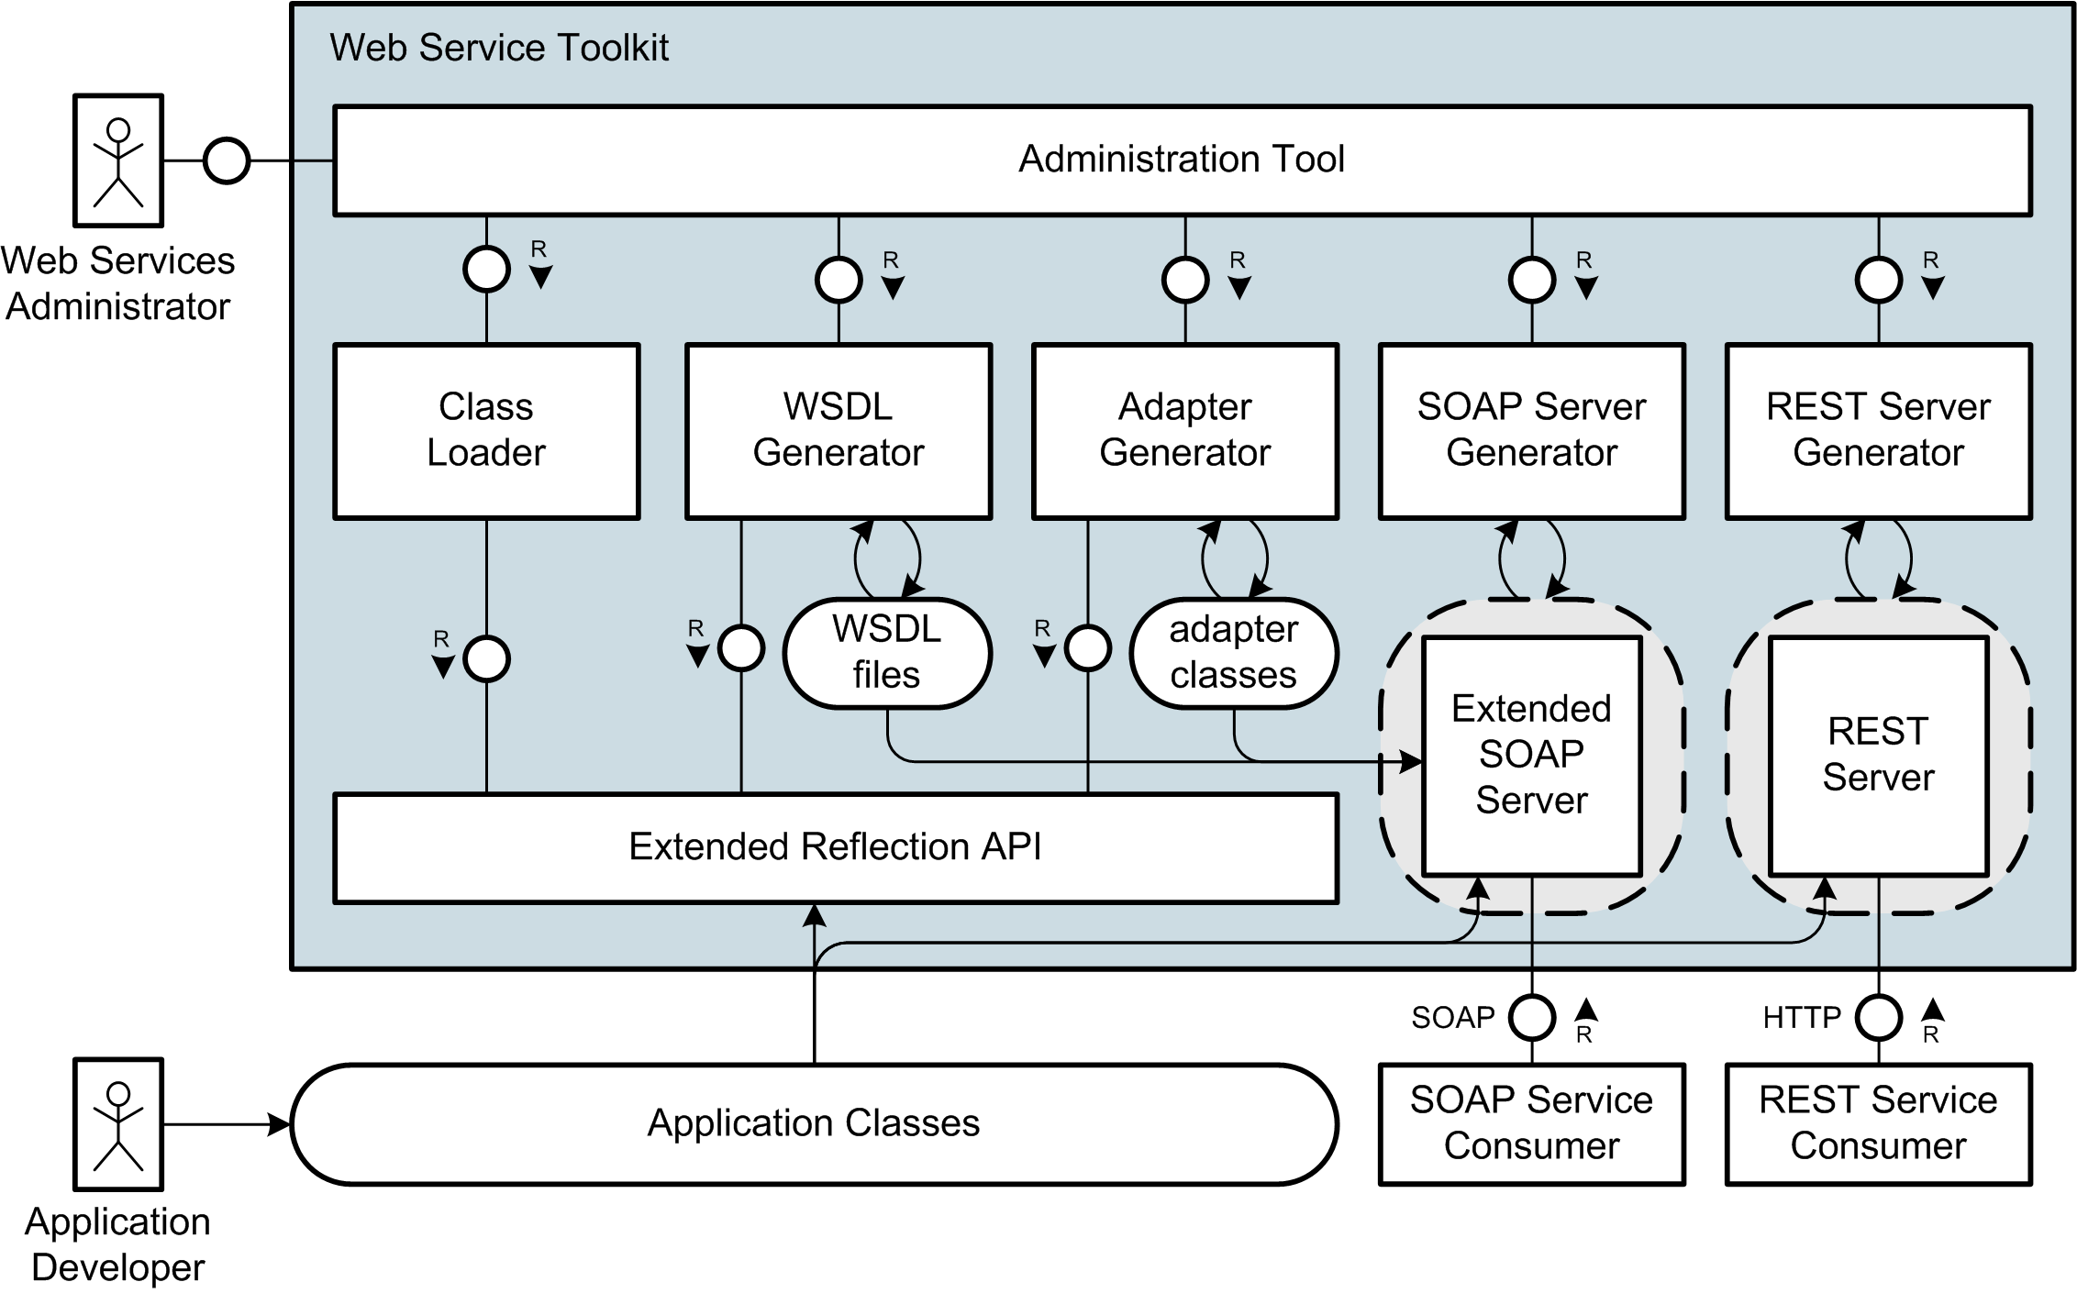
Interaction Overview

Slide 21
Live Demo

Slide 22
Live Demo

Slide 23
Example Application
Application: Answering Machine
Number of Calls
List of Calls
Example Web Service
using SOAP Protocol
Notes:
Wichtige Punkt für solch einen Web Service
Gesichert durch Authentifizierung
Hier einfaches user/passwort
Je nach scenario vielleciht auch über client-zertifikate usw.
Notwendig einerseits für zugriffskontrolle
Andererseits fürs Abbrechnen der Zugriffe/Billing

Slide 24
Generation Steps
Creating Web Services without Tool Support:
Create XML Schema for Data Types
Write WSDL Description
Own Wrapping for Document/Literal
Include Documentation
Build SOAP Server Script
No WS-Security Support
InstantSVC automates all Steps

Slide 25
Components of InstantSVC

Slide 26
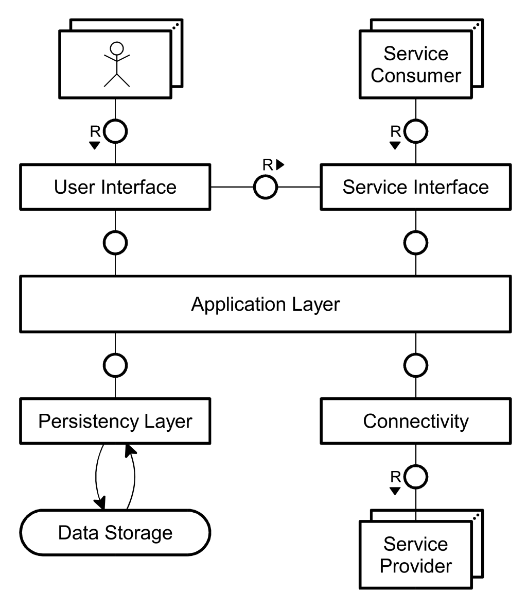
Proposed Application Architecture

Slide 27
Summary
For SOAP Services
WSDL generation from annotated PHP code
Handler chain mechanism for SOAP processing
For REST Services
Custom mapping of functionality to REST resources
Custom serialization handling
Open Your Services to the Public!
→Escape from the Silos ;)

Slide 28


Further Information and Download at:
http://instantsvc.sourceforge.net

Slide 29
BACKUP Slides

Slide 31
Suggested Reading
White Papers
[1] Einführung in XML Web Services, October 2005
[2] Web Services Facade for PHP5 – Konzeption, January 2006
[3] Web Service Toolkit für PHP5, March 2006 download at http://instantsvc.sf.net/
Further Sources
[4] RESTful Web Services, January 2006 http://www.stefan-marr.de/artikel/restful-web-services.html
[5] SOAP Version 1.2 specification, W3C Recommendation, June 2003. http://www.w3.org/TR/soap/
[6] Web Services Description Language (WSDL) 1.1, W3C Note, March 2001. http://www.w3.org/TR/wsdl/
[7] Username Token Profile 1.0, OASIS, January 2004 http://docs.oasis-open.org/wss/2004/01/oasis-200401-wss-username-token-profile-1.0.pdf

Slide 32
The Core Web Services Protocol Stack
Discovery | UDDI (Itself a Web Service)
Description | WSDL, WSFL/XLANG, others to come
Access | SOAP, SOAP with Attachments, XML-RPC, REST
Transfer | HTTP, SMTP, FTP, others
Transport | TCP/IP, UDP, others

Slide 33
Components of InstantSVC

